Slide 1
What is Aesthetics?

Slide 2
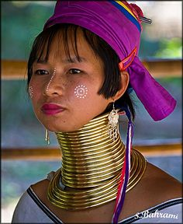
Aesthetics:
What is beauty?
Why do we find certain things more beautiful than others?
Notes:
Beauty is a sensory experience that provides the viewer with pleasure or satisfaction.
Aethetics is a branch of philosophy that deals with the principles of beauty and artistic taste. The study of aesthetics is the study of why different people find different things beautiful. This is why different cultures have different ideas of beauty. (America vs Burma)
When Americans think of a beautiful woman, they often think of someone like the woman on the left.
But in Burma, the woman on the right would be considered beautiful because of her elongated neck, the markings on her face, the colors in her head wrap, etc.

Slide 3
Aesthetics in Art: WHY Do you Like It?
Personal - Based on experiences you have had (Reminds me of when I …)
Formal - Based on elements and Principles of Art & Design (I like the way colors, lines, shapes, etc are used)
Contextual - Historical & Cultural significance (Reminds me of what I already know about …)
Notes:
It can be difficult to explain why you like something without saying “I don’t know, I just do.”
Use examples of art around the room to model this for them.

Slide 4
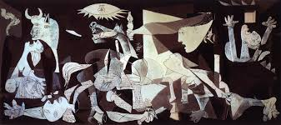
Do you like this painting? Why or why not?
“Guernica” Pablo Picasso
Is it because of how it looks, what it reminded you of or because you know the historical events around this time?
Notes:
Do you enjoy this piece of artwork?

Slide 5
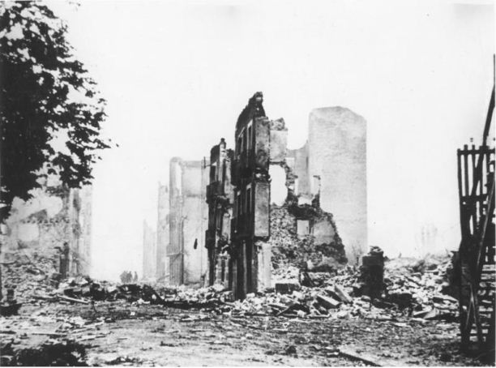
1936: Civil War in Spain, led by General Franco to overthrow government.
April 26, 1937:
German bombers in
Spanish town.
Experimental warfare (How much would it take to bomb a city to oblivion?)
Notes:
This is the history behind the Picasso’s Guernica.

Slide 6
Love It!
Hate It!
Three ways to consider Aesthetics in Art
Formal - Elements/Principles (like colors or shapes)
Personal - Relates to your life experiences
Contextual - Historical & cultural influences
Notes:
Now, based on the historical context for the painting, do you appreciated the artwork?

